Slide 1

EMERGING METHODS FOR EARLY DETECTION
OF FOREST FIRES
Team ID: PNT2022TMID41278
Team Lead: Elankumaran R
Team Members: Dinesh P
Subash chandra bose C
Raj kumar KS
Mentor:Dr.Thiyagarajan Rathinam

Slide 2

INTRODUCTION
Forest fires - >environmental issue - economic and ecological damage about 100,000 wildfires -US .
-> 9 million acres -destroyed - difficult - predict and detect - populated forest area- prediction -ground-based methods -Camera or Video-Based approach.
->Satellites - important source of data -reliability and efficiency.
-> low spatial resolution - low temporal resolution-drawback of

Slide 3

MAIN OBJECTIVE
Considering - impacts - main motive- IS
TO
1]. Detection of fire as soon as possible
2]. Fast delivery of alert message to respective person

Slide 4



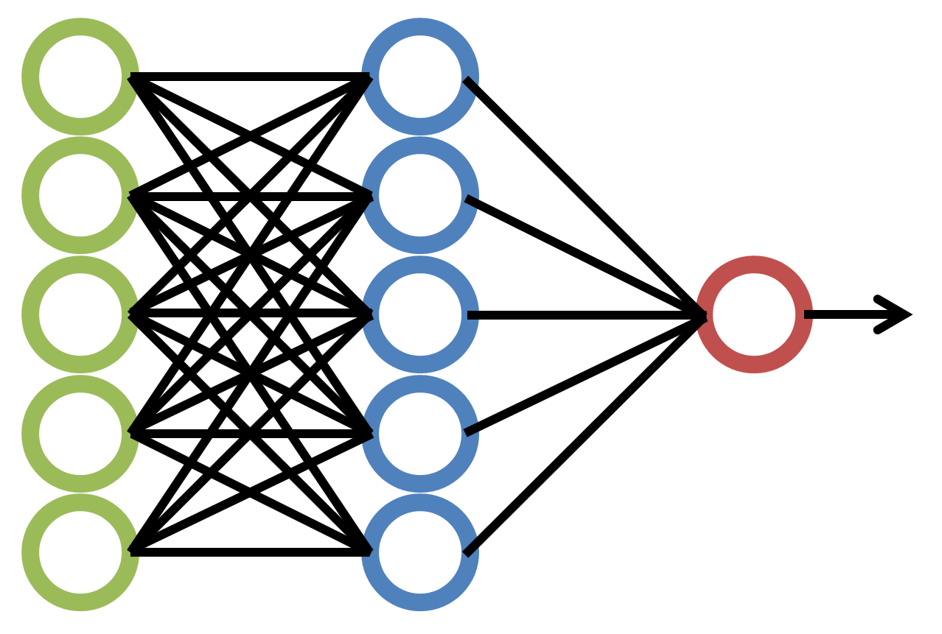



FLOW DIAGRAM
VIDEO TO FRAMES
MACHINE LEARNING
CNN
YES
NO

Slide 5



METHODOLOGIES
1]. Jupyter notebook
2]. Anaconda
3]. Python 3
4]. Python flask
5]. Twilio
6].Google colab
7]. IBM watson studio
8]. IBM Cloud

Slide 6

GOOGLE COLAB
=>Developed a-code - deploy a-model o- detection -patterns - forest fire
=> if - pattern - detected - succeeded - prediction module.
=> provided -conditions - satisfied - will - interlinking - model to - Twilio

Slide 7

IBM WATSON STUDIO
=>A part - IBM cloud - precise - used - create -model
=>Hold- test - train -phase
=>Datasets - present - cloud
=>Model - accessed - registered model id - space id - called - execution

Slide 8

TWILIO
=>Online - resource - used - send sms- registered - numbers
=> Project - interlinked - command prompt - jupyter notebook - proper coding - providing - account and token number -send alert -message .
=> Can - interlinked - jupyter - installing - lib functions

Slide 9

FUTURE CHALLENGES
=>Forest- protection- extinction-species
=>Model- upgrade
=> Dynamic - adaptation
=>Address - airpollution

Slide 10

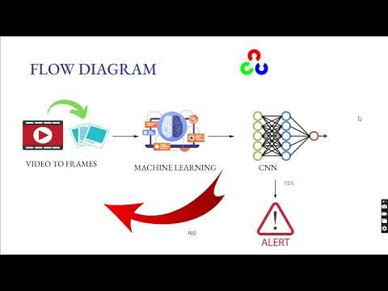
DEMONSTRATION VIDEO
LINKS - https://youtu.be/btlY61icF_A
-Drive link

Slide 11

REFERENCES
1]. Chen, Y., Zhang, Y., Xin, J., Wang, G., Mu, L., Yi, Y., Liu, H. and Liu, D., 2019, June. UAV image-based forest fire detection approach using convolutional neural network. In 2019 14th IEEE conference on industrial electronics and applications (ICIEA) (pp. 2118-2123). IEEE.
2]. Chen, Y., Zhang, Y., Xin, J., Wang, G., Mu, L., Yi, Y., Liu, H. and Liu, D., 2019, June. UAV image-based forest fire detection approach using convolutional neural network. In 2019 14th IEEE conference on industrial electronics and applications (ICIEA) (pp. 2118-2123). IEEE.
3].Zhang, Q.X., Lin, G.H., Zhang, Y.M., Xu, G. and Wang, J.J., 2018. Wildland forest fire smoke detection based on faster R-CNN using synthetic smoke images. Procedia engineering, 211, pp.441-446.

Slide 12


